Slide 1
Sources of Evidence in Network Forensics
COMP6348001
Network Forensics
Dr. Don
Notes:
Welcome back to our Network Forensics class. This week, we’ll talk about Sources of Evidence in Network Forensics. Last week we looked at the big picture and methodology. Now we’ll dig into where the actual proof of an attack comes from.

Slide 2
Learning Objectives
By the end of this session, you will be able to:
Identify different sources of network evidence
Explain the difference between packet captures, flow records, and logs
Distinguish between volatile and non-volatile evidence
Understand the importance of integrity and the chain of custody
Correlate multiple evidence sources in an investigation
Notes:
By the end of this session, you should be able to identify different sources of evidence in a network, explain packet captures, flow records, and logs, distinguish volatile versus non-volatile evidence, understand chain of custody and integrity, and finally, learn how to correlate different sources to build a complete investigation.

Slide 3
Why Evidence Matters
Evidence = foundation of a forensic investigation
Without evidence, no proof of intrusion
Determines what happened, when, and how
Notes:
Evidence is the foundation of any forensic investigation. Without evidence, we can’t prove an intrusion, we can’t explain what happened, and we certainly can’t hold anyone accountable.
Let’s look at two cases.

Slide 4
International Case: Equifax Data Breach (2017, USA)
Evidence Sources Used:
Firewall logs → flagged suspicious inbound requests
Web server logs → revealed malicious Struts exploit commands
Database logs → confirmed unauthorized queries
NetFlow → showed large outbound data transfers
Result:
Investigators confirmed exfiltration of 147M records
Equifax fined $700M for poor patching and monitoring
Notes:
Internationally, the Equifax breach in 2017. Attackers exploited a vulnerability in Apache Struts. Evidence sources included firewall logs that flagged suspicious requests, web server logs that revealed the exploit commands, database logs that confirmed unauthorized queries, and NetFlow that showed huge outbound transfers. The result? Investigators confirmed the exfiltration of 147 million records, and Equifax was fined 700 million dollars.

Slide 5
Local Case: Tokopedia Data Breach (2020, Indonesia)
Evidence Sources Used:
Application server logs → SQL injection attempts
Firewall & IDS logs → abnormal queries bypassing filters
Database logs → mass dumping of user accounts
NetFlow → outbound traffic to unknown IPs abroad
Result:
91M accounts leaked and sold on the dark web
Highlighted weak log monitoring and input validation
Notes:
Locally, in Indonesia, Tokopedia’s 2020 breach. Application server logs showed SQL injection attempts, firewall and IDS logs revealed abnormal queries, database logs showed a mass dump of accounts, and NetFlow showed outbound traffic to unknown IPs. The result was 91 million accounts sold on the dark web, exposing weak monitoring and poor validation practices.
Both cases remind us that evidence is the only way to reconstruct what really happened.

Slide 6
Types of Digital Evidence
Packet Captures (pcap files)
Full traffic contents
Tools: Wireshark, tcpdump
Flow Records (NetFlow, sFlow, IPFIX)
Summary of communications (source/destination, bytes, duration)
Device Logs
Routers, switches, firewalls, proxies
System Logs
OS event logs, authentication records
IDS/IPS Alerts
Detected attacks or anomalies
Notes:
In network forensics, evidence comes in several forms:
Packet captures, the raw traffic, often analyzed with tools like Wireshark.
Flow records like NetFlow, which summarize communications without full content.
Device logs from routers, switches, and firewalls.
System logs, which include OS and authentication data.
IDS or IPS alerts, which raise the flag on suspicious behavior.
Each type of evidence has its strengths and weaknesses.”

Slide 7
Packet Captures
Richest detail (headers + payload)
Useful for: protocol analysis, reconstructing conversations, malware detection
Downsides:
Very large files
May contain sensitive/private data
Notes:
Packet captures are the richest source. They contain headers and payloads, so they let us reconstruct conversations, detect malware, and analyze protocols. But the downside is they generate massive files and may contain sensitive data.

Slide 8
Case: SolarWinds Attack (2020, Global)
Evidence Sources Used:
Pcaps from internal traffic → suspicious HTTPS callbacks
DNS logs → confirmed connections to attacker domains
Result:
Investigators identified malware “backdoor” communication
Attribution to the Russian APT group
Notes:
Global example: SolarWinds attack in 2020. Pcaps revealed suspicious HTTPS callbacks, and DNS logs confirmed connections to attacker domains. Result: investigators uncovered a backdoor linked to a Russian APT.

Slide 9
Case: Kominfo Website Defacement (2018, Indonesia)
Evidence Sources Used:
Pcaps → captured SQL injection payloads in HTTP requests
Web server logs → matched malicious requests with defacement
Result:
Attack method confirmed
Helped secure other government websites with similar flaws
Notes:
Local example: Kominfo website defacement in 2018. Pcaps captured SQL injection payloads, and web server logs matched those requests with the defacement. The result was that investigators confirmed the attack method and secured other government sites.”

Slide 10
Flow Records
Metadata only (no content)
Tracks “who talked to whom, when, and how much”
Lightweight → easier to store long term
Useful for detecting trends (e.g., DDoS, data exfiltration)
Notes:
Flow records don’t contain content, just metadata about who talked to whom, when, and how much. They’re lighter, easier to store, and great for spotting trends like DDoS or data exfiltration.

Slide 11
Case: DDoS Attack on GitHub (2018, Global)
Evidence Sources Used:
NetFlow records → showed a sudden spike from Memcached servers
Router logs → confirmed amplification traffic patterns
Result:
GitHub mitigated an attack with Akamai
Largest DDoS at that time (1.35 Tbps) was successfully stopped
Notes:
Global case: GitHub DDoS attack in 2018. NetFlow records showed a sudden spike from Memcached servers, and router logs confirmed amplification traffic. Result: GitHub worked with Akamai to mitigate the largest DDoS attack of its time.

Slide 12
Case: Bank BRI ATM Malware Incident (2019, Indonesia)
Evidence Sources Used:
Flow logs → unusual spikes in ATM-to-external connections
Firewall logs → showed communication to attacker servers
Result:
Identified compromised ATM terminals
Prevented further fraudulent withdrawals
Notes:
Local case: Bank BRI ATM malware in 2019. Flow logs showed unusual spikes from ATMs to external IPs, and firewall logs confirmed communication with attacker servers. Result: compromised ATMs were identified, preventing further fraudulent withdrawals.

Slide 13
Device Logs
Router: NetFlow, routing tables, ARP cache
Switch: MAC tables, VLAN info
Firewall: allow/deny logs, intrusion attempts, suspicious traffic
Example:
Firewall log entry: [Denied] 192.168.10.5 → 45.77.22.19 TCP 3389 at 02:15:03
Notes:
Routers, switches, and firewalls all keep logs that are valuable in investigations. A firewall log entry like ‘Denied connection at 2 a.m.’ may be the first clue of an intrusion attempt

Slide 14
Case: Marriott Data Breach (2018, Global)
Evidence Sources Used:
Firewall logs → repeated unauthorized remote connections
Router logs → abnormal routing entries
Result:
Discovered attackers had persisted in the network since 2014
500M customer records stolen
Notes:
Global case: Marriott breach in 2018. Firewall logs revealed repeated unauthorized connections, and router logs showed abnormal routing. Result: investigators discovered attackers had been inside since 2014, stealing 500 million records.

Slide 15
Telkomsel Data Leak (2017, Indonesia)
Evidence Sources Used:
Firewall logs → SQL injection attempts bypassed filters
Web server logs → confirmed database queries via injection
Result:
Millions of customer data leaked
Exposed weak application security
Notes:
Local case: Telkomsel leak in 2017. Firewall logs showed SQL injection attempts, and web server logs confirmed database queries. The result was millions of customer records exposed due to weak application security.”

Slide 16
System & Application Logs
Windows: Event Viewer (logon failures, account lockouts)
Linux: /var/log/auth.log, /var/log/syslog
Applications: Web server access logs, email server logs
Example:
Apache log: 192.168.1.5 - - [12/Mar/2025:13:05] "GET /login.php?id=1' OR '1'='1" 200 → Attempted SQL injection visible in log.
Notes:
System logs track authentication and activity, while application logs can show misuse of services.

Slide 17
Case: Sony Pictures Hack (2014, Global)
Evidence Sources Used:
System logs → unusual logins from foreign IPs
Application logs → large file access requests before wipe
Result:
Linked to Lazarus Group (North Korea)
Attack disrupted global movie releases
Notes:
Global case: Sony Pictures hack in 2014. System logs showed unusual logins from foreign IPs, and application logs revealed large file access before servers were wiped. Result: linked to Lazarus Group, disrupting movie releases worldwide.

Slide 18
Case: BPJS Kesehatan Data Leak (2021, Indonesia)
Evidence Sources Used:
Database logs → massive SELECT queries by unauthorized users
System logs → abnormal admin activity from foreign IPs
Result:
279M citizen records leaked to dark web
Became a national cybersecurity crisis
Notes:
Local case: BPJS Kesehatan data leak in 2021. Database logs showed massive unauthorized queries, and system logs revealed abnormal admin activity from foreign IPs. Result: 279 million records leaked to the dark web, creating a national crisis.”

Slide 19
DS/IPS Alerts
Signature-based (Snort, Suricata)
Anomaly-based (detects unusual behavior)
Useful for early detection, but may produce false positives
Example:
Snort alert: [1:1000001:0] SQL Injection Attempt detected from 203.0.113.10 → 192.168.1.20
Notes:
IDS and IPS provide early detection, though they can raise false positives.

Slide 20
Case: Colonial Pipeline Ransomware (2021, USA)
Evidence Sources Used:
IDS alerts → malicious SMB traffic flagged
Firewall logs → unusual lateral movement
Result:
Ransomware identified as DarkSide group
Led to $4.4M ransom payment and a major fuel shortage
Notes:
Global case: Colonial Pipeline ransomware in 2021. IDS flagged malicious SMB traffic, and firewall logs revealed unusual lateral movement. Result: ransomware was identified as DarkSide, leading to a $4.4M ransom and major fuel shortages.

Slide 21
Case: Indonesian University Ransomware Attacks (2020–2021)
Evidence Sources Used:
IDS alerts → brute force attempts and abnormal SMB traffic
System logs → unauthorized privilege escalation
Result:
Confirmed ransomware infections at multiple universities
Forced shutdowns and delays in academic operations
Notes:
Local case: Indonesian university ransomware in 2020–2021. IDS detected brute force attempts, and system logs confirmed privilege escalation. Result: multiple universities suffered ransomware shutdowns.

Slide 22
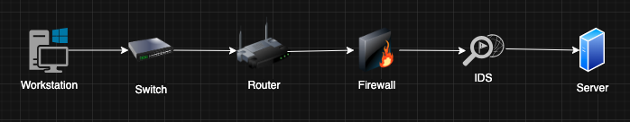
Evidence Across the Network Environment
Each component = possible crime scene:
Client → browser history, DNS cache
Switch → MAC table entries
Router → NetFlow, routing info
Firewall → connection attempts, blocked traffic
IDS/IPS → alerts and logs
Server → access/authentication logs
Notes:
A typical network has many components: clients, switches, routers, firewalls, IDS, and servers. Each is a potential crime scene. Browser history, MAC tables, routing info, connection attempts, alerts, and authentication logs all provide evidence to be collected and correlated.

Slide 23
Volatile vs Non-Volatile Evidence
Volatile: disappears quickly (RAM data, active TCP sessions, live ARP tables)
Non-Volatile: persists over time (logs, archived flows, disk images)
Key Rule: Collect volatile evidence first.
Notes:
olatile evidence, like RAM or active sessions, disappears quickly. Non-volatile evidence, like logs and archives, persists. The golden rule: always collect volatile evidence first before it’s gone.

Slide 24
Chain of Custody
Document: who, when, where, how evidence was collected
Prevents tampering claims
Ensures admissibility in court
Example: Investigator signs the evidence log when handing the pcap to a colleague.
Notes:
Chain of custody means carefully documenting who collected evidence, when, where, and how. This prevents tampering claims and ensures evidence can stand in court. For example, signing the evidence log when passing a pcap to a colleague.

Slide 25
Evidence Integrity
Use hashing (MD5, SHA-256) to prove data unchanged
Hash before and after transfer/storage
If hashes differ → evidence compromised
Case: Court rejected log file because no hash was provided → integrity unverified.
Notes:
To prove evidence wasn’t altered, we hash files with algorithms like SHA-256. If the hash changes, the file has been tampered with. Courts have rejected evidence without hashes, since integrity couldn’t be verified.

Slide 26
Case: LinkedIn Data Breach (2021, Global)
Evidence Sources Used:
Web server logs → automated scraping activity
Firewall logs → high-volume queries from the same IPs
IDS alerts → detected scraping patterns but deprioritized
Result:
700M user profiles scraped and sold online
Raised debate on data scraping legality vs hacking
Notes:
Global case: LinkedIn data breach 2021.
Web server logs showed automated scraping, firewall logs showed high-volume queries, and IDS alerts detected patterns.
Result: 700M profiles scraped, sparking debate about legality.

Slide 27
Case: Indonesian COVID-19 Contact Tracing App Leak (2021)
Evidence Sources Used:
Application logs → unauthorized API calls
Server logs → bulk queries from external IP ranges
Result:
Millions of vaccination records leaked
Public trust in e-health systems is damaged
Notes:
Local case: Indonesian COVID-19 contact tracing app leak.
Application logs revealed unauthorized API calls, and server logs showed bulk queries.
Result: millions of vaccination records leaked, damaging public trust in e-health.”

Slide 28
Correlation of Evidence
A single source is rarely enough
Cross-check logs, PCAPs, IDS alerts, and system logs
Provides a timeline and attack chain
Example: DDoS Attack
Firewall → sudden traffic spike
Router → confirmed source IP ranges
IDS → matched known DDoS patterns
Notes:
No single log tells the whole story. Investigators must cross-check logs, pcaps, IDS alerts, and system records to build a timeline and attack chain.
Example: in a DDoS attack, firewall logs reveal spikes, router logs confirm IP sources, and IDS alerts match known attack patterns.

Slide 29
Best Practices in Evidence Handling
Prioritize volatile evidence
Always hash and timestamp data
Store securely (encrypted, access controlled)
Document every step clearly
Notes:
When handling evidence: prioritize volatile data, hash and timestamp files, store securely, and document every step. Mistakes in these basics can make evidence useless in court.

Slide 30
Big Discussion: Investigating a Ransomware Case
If you were the investigator in a ransomware case, which evidence sources would you prioritize and why?
Notes:
Now, let’s bring everything together with a big discussion.
Imagine this: A company reports that several servers and workstations have been encrypted by ransomware. They need us to figure out how the attackers got in, how the malware spread, and if any data was stolen before encryption.
We’ve learned about packet captures, flow records, logs, and alerts. Which of these evidence sources would you look at first? And how would you build your investigation?

Slide 31
Big Discussion: Investigating a Ransomware Case
Firewalls (entry point)
Email server logs (phishing vector)
Workstation logs (infection traces)
IDS alerts (malware communication)
NetFlow (C2 communication at odd hours)
Sample Answer:
Start with the firewall and email server logs to confirm the entry point
Then workstation logs for the initial infection
Correlate with IDS/NetFlow to detect C2 servers
Build a full timeline of the attack
Notes:
Entry Point (Initial Access)
Evidence Sources Used:
Email server logs → suspicious attachments or phishing links
Firewall logs → inbound RDP or SMB connections from unknown IPs
Result: Identify if the ransomware came through phishing or remote exploitation.
Infection Spread (Lateral Movement)
Evidence Sources Used:
IDS alerts → brute force or abnormal SMB traffic
System logs (Windows Event Viewer, Linux auth logs) → unusual admin logins
Switch/router logs → connections between infected hosts
Result: Track how the malware moved from one machine to others.
Command & Control (C2) and Data Theft
Evidence Sources Used:
NetFlow → large outbound traffic to suspicious IPs abroad
Pcaps → confirm C2 traffic patterns or data uploads
IDS alerts → known ransomware signatures
Result: Determine if attackers only encrypted files or also exfiltrated sensitive data.
Encryption and Impact
Evidence Sources Used:
System logs → mass file access before encryption
Application logs → database access anomalies
Result: Confirm when encryption began and which systems were hit.
Reporting & Lessons
Evidence Sources Used:
All correlated logs, pcaps, NetFlow, IDS alerts
Result: Build a clear timeline: Phishing email → lateral spread via SMB → C2 communication → encryption event.
Sample Answers (What Students Might Say)
“I would start with the email server logs to see if phishing was the entry point, because most ransomware starts there.”
“Firewall and IDS logs are critical to detect brute force attempts or unusual remote access.”
“NetFlow is useful to check if there was data theft before encryption.”
“System logs would confirm abnormal admin access and show the timeline of the spread.”
“By combining these, we can reconstruct the attack chain and prove exactly what happened.”

Slide 32
Hands-on

Slide 33
DNS Traffic
Convert names to IP Addresses
Transfer information between DNS servers
Find the name from IP addresses
Lookup other name elements
Uses both TCP and UDP port 53
TCP used just for zone transfers
mDNS (multicast DNS) is a way to use name resolution without a DNS server

Slide 34
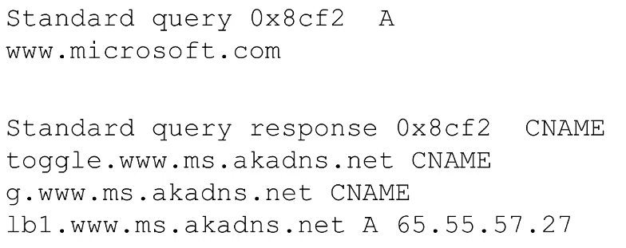
Normal DNS Traffic
Notes:
CNAME = Canonical Name or alias

Slide 35
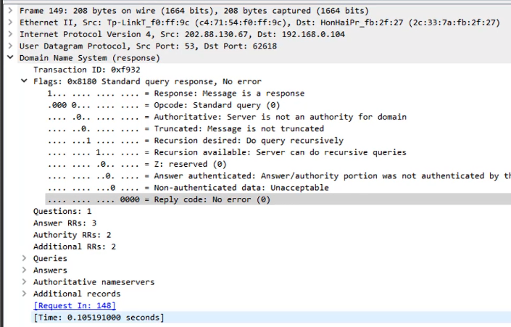
Notes:
RRS = Resource Records

Slide 36
DNS Types
A Record (Address Record) – Maps a domain name to an IPv4 address.
AAAA Record – Maps a domain name to an IPv6 address.
CNAME (Canonical Name) – Creates an alias from one domain name to another.
MX (Mail Exchange) – Directs email to a mail server.
NS (Name Server) – Identifies the authoritative name servers for the domain.
TXT (Text Record) – Stores text data, often for email security (SPF, DKIM, DMARC).
PTR (Pointer Record) – Reverse lookup: maps an IP address back to a domain name.
SOA (Start of Authority) – Provides administrative details about the domain and DNS zone.

Slide 37
Download and open week 2 - dns.cap

Slide 38
What DNS record types are seen in the trace file?
Answer: TXT, A, AAAA, NS, MX, PTR, SRV

Slide 39
How many DNS servers are in this trace file?
Answer: 4

Slide 40
How many requests and how many responses are seen here?
Answer: 19 each. (use filter: dns.flags.response == 0 or dns.flags.response == 1)

Slide 41
For which names was the IPv6 address requested?
Answer: 12 (filter used: dns.qry.type == 28)
Record | Code | Meaning
A | 1 | IPv4 address
NS | 2 | Authoritative name server
CNAME | 5 | Canonical name (alias)
SOA | 6 | Start of authority
PTR | 12 | Reverse DNS pointer
MX | 15 | Mail exchange
TXT | 16 | Text record (SPF/DKIM, etc.)
AAAA | 28 | IPv6 address
SRV | 33 | Service locator
ANY | 255 | Request all records

Slide 42
How many name error conditions occurred?
Answer: 6 (filter used: dns.flags.rcode == 3)

Slide 43
For which requests did those errors occur?
Answer: www.example.notginh

Slide 44
Summary & Reflection
Evidence types: packets, flows, logs, alerts
Volatile vs non-volatile → capture in the right order
Chain of custody + hashing = integrity
Multiple sources must be correlated
Real-life cases prove that evidence is the backbone of network forensics
Notes:
Today we covered:
Sources of network evidence
Packets, flows, logs, and alerts
Volatile vs non-volatile evidence
Chain of custody and hashing
Correlating multiple evidence types And we reinforced this with both global and Indonesian case studies.
The key message: evidence is the backbone of network forensics.”

Slide 45
See you next week!

